Slide 1
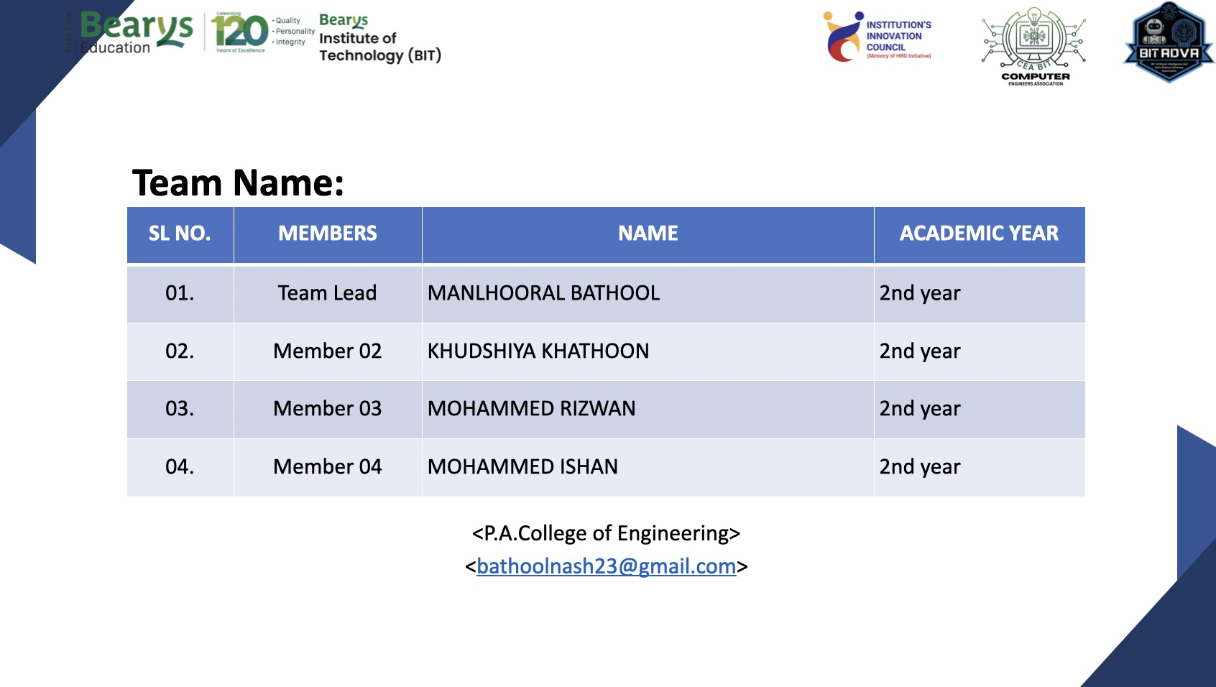

Slide 2
Theme: Energy Conservation and Digitization
INTELLIGENT ENERGY OPTIMIZATION SYSTEM
Our Theme
The Core Problem
Smart energy management using AI, IoT, automation & behavioral motivation
Monitoring systems track energy but fail to drive real behavioral change
Why Existing Systems Failed:
Users ignored repetitive alerts and dashboards
No motivation or rewards were provided
Monitoring did not lead to real action
Energy consumption patterns continued
Occupancy patterns were not considered
"Monitoring alone could not create real energy-saving behavior."

Slide 3
Theme: Energy Conservation and Digitization
Previous Solution
Existing System Features
Issues Identified
Real-time dashboards
Floor-wise energy tracking
Device-level monitoring
Automated alerts
Initially generated interest among administrators
Alerts became repetitive and easy to ignore
Data was difficult for non-technical users
No incentives for saving energy
System focused on monitoring, not optimization
Manual overrides bypassed automation
"The system showed energy data but failed to encourage behavioral change."

Slide 4
Theme: Energy Conservation and Digitization
Present Solution
Smart Alert System
Visual Indicators
50% Awareness
75% Warning
100% Critical
Green Tree = Efficient Usage
Department-based energy limits with smart meters and plugs tracking usage continuously
Yellow Tree = Moderate Usage
Wilted Tree = Excessive Usage
Reward & Motivation System
Automated Optimization
Earn points for:
Turning OFF unnecessary lights & fans
Using AC responsibly, avoiding idle devices
Staying within energy limits
When rooms are empty:
Lights & fans auto turn OFF
AC switches to eco mode
Idle systems enter sleep mode
"Our solution combines automation, teamwork, and behavioral motivation."

Slide 5
Theme: Energy Conservation and Digitization
Solution Overview — How Our System Works
1
2
3
4
5
Smart Monitoring
Intelligent Analysis
Alerts & Notifications
Automated Control
User Engagement
Smart meters track usage
PIR sensors detect occupancy
Smart plugs control devices
Usage patterns
Idle devices
Peak consumption
Department limits
50% Awareness
75% Warning
100% Critical
Auto OFF lights & fans
AC eco mode
Disconnect idle devices
Tree indicators
Leaderboards
Rewards
Complete Pipeline: Monitor → Analyze → Alert → Automate → Engage → Save Energy

Slide 6
Theme: Energy Conservation and Digitization
System Flow
INPUT →
Smart Meter + PIR Sensor + Smart Plug
Energy Data Collection
PROCESS →
Intelligent Data Analysis
50% / 75% / 100% Alerts
Automatic Device Control
OUTPUT →
Dashboard + Tree Indicators
Leaderboard & Rewards
Reduced Energy Consumption

Slide 7
Theme: Energy Conservation and Digitization
Future Scope & Conclusion
Future Scope
Key Insight
AI-based predictive energy optimization
Mobile app integration
Solar energy integration
Voice-controlled automation
Smart campus expansion
Cloud-based analytics
"People do not change behavior just by seeing data. They change behavior when the system is simple, engaging, automated, competitive, and rewarding."
"Our system not only monitors electricity usage but also creates
awareness, accountability, automation, and motivation to achieve real energy-saving behavior."

